Slide 1
Thrive in chaos
Martijn van Arkel
.NET developer
Pizzasessie
7 augustus 2025

Slide 2

Martijn van Arkel
.NET developer
At 4DotNet

Slide 3
Things that can go wrong
Misconfiguration
Broken code deployed
Unexpected spike in load
Resources not scaled correctly
External service unavailable
Azure outage
And many more….

Slide 4


Slide 5
We all try to build resilient systems
🤔
How do I know they work as designed?

Slide 6

Chaos engineering

Slide 7
Is chaos engineering a new fancy buzz word?
I think. NO

Slide 8
What is chaos engineering
“Chaos engineering is the practice of intentionally injecting faults into a system to test its resilience. The goal is to identify potential failure points and correct them before they cause an actual outage or other disruption.” Source: https://www.opentext.com/what-is/chaos-engineering#:~:text=Chaos%20engineering%20is%20the%20practice,actual%20outage%20or%20other%20disruption “Chaos Engineering is the discipline of experimenting on a system in order to build confidence in the system’s capability to withstand turbulent conditions in production.” Source: https://principlesofchaos.org/

Slide 9

Apple 1983
Steve Capps developed monkey.
Monkey rapidly generates and sends random user input.
Monkey was used to test MacWrite and MacPaint
Source: https://books.sorryapp.com/2/incident-communication-101/26/pioneers-of-modern-incident-management

Slide 10
Prologue 1992
James Marshall developed ‘La Matraque’
La Matraque was ran in the last couple of days before a production release. It generated random valid and invalid UI events at high speed.
Later database and file access instructions were added
Source: https://en.wikipedia.org/wiki/Chaos_engineering

Slide 11

Amazon 2003
Jesse Robins(aka ‘Master of Disaster’)
Created a program called ‘Game Day’. During Game Day real incidents are simulated.
Source: https://books.sorryapp.com/2/incident-communication-101/26/pioneers-of-modern-incident-management

Slide 12

Google 2006
Kripa Krishnan created ‘DiRT’.
DiRT is a program similar too Game Day where real incidents are simulated to test systems

Slide 13
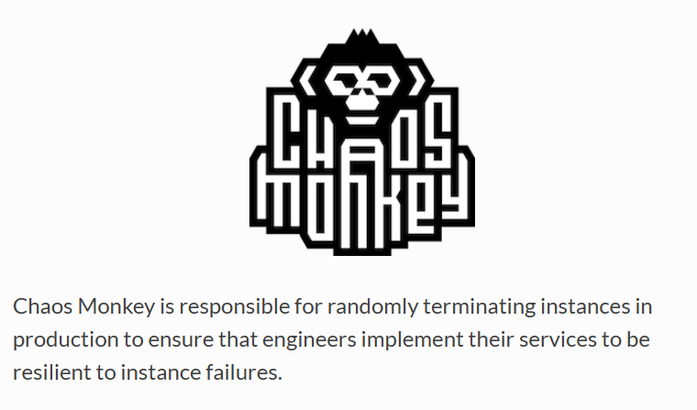
Netflix - 2011
Chaos Monkey: Takes down random instances
Chaos Kong: Takes down an entire service
Chaos Gorilla: Takes down an entire AWS region
Source: https://youtu.be/ZBk8oCmfpMg?si=0tcwlUtA1Fx-aidi&t=1404
Notes:
Chaos Monkey kills a single instance
Chaos Kong kills an entire service Chaos Gorilla kill an entire region

Slide 14

How to start
Let’s turn random things of like Netflix

Slide 15

How to start
Identify what can fail
Look at what has been put in place to prevent/handle a failure
Don’t start randomly turning off things

Slide 16
Experiments
Hypothesis
Learn and make improve
Design
experiment
Observe system behaviour
Inject chaos

Slide 17
Example experiment
Context: Online system the buy concert tickets
When the service to buy tickets has an outage in West Europe
Success conditions
All requests are redirected to North Europe
At least 95% of requests are successful
At least 95% of requests complete within 1 second

Slide 18
Example experiment
Context: And service listens to a service bus and sends invoices to customers
The entire service has an outage
Success conditions
When the service is back online every invoice is still sent
No duplicate invoices are sent

Slide 19
When to run experiments
Do not run experiments when there is an actual outage
When the system has been designed to handle the failure
Regularly to ensure the system keeps behaving as designed
🕝

Slide 20

Where to run experiments
But let’s not start there

Slide 21



Tools in Azure
Azure chaos studio
Define and run experiments
Sadly, not all everything is supported
Azure Load Testing
Add stress to your system during experiments

Slide 22
Let’s look at Chaos Studio

Slide 23
Risks
Real failures are injected
Experiments on can impact customers
Unexpected dependencies causing a bigger failure than expected
⚠️

Slide 24
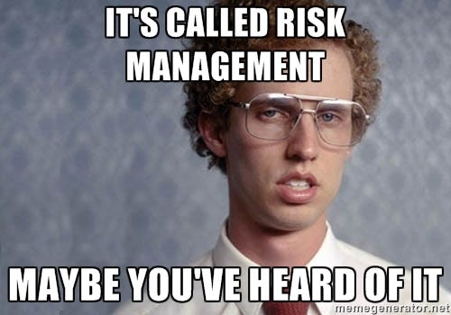
Reducing risk
Do not start on production
Always have a way to stop an experiment
Have monitoring setup
Give experiment the minimal permissions
Start with small experiments and minimize the blast radius
Communicate beforehand

Slide 25

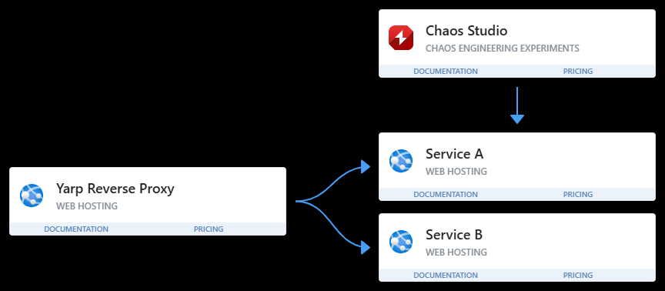
Demo

Slide 26
Why I think you should consider chaos engineering
Identify problems before an actual outage happens
Know how the system behaves when things go wrong
Getting confidence in the resilience of the system
Ensure issues that caused problems do not happen again

Slide 27

When do you want to find out if your emergency plan works?

Slide 28

Questions
https://github.com/marti901/thrive-in-chaos

